Slide 1
ConnectNow How to Get Out What You Put In?!
Eva Heininger
Parishsoft

Slide 2
The Heart of the Matter
What information?
Who? Registered?
Why do you need it?
How do you need it?

Slide 3
What information?
Address 1, City, State, Zip
Envelope Number
Ages
Wedding Anniversary
Sacraments

Slide 4
Who?
Registered Families?
Members?
Children?
First Communions from last weekend?
All your single members who you can date?

Slide 5
Why do you need it?
Communicate with them
Diocese asking
Pastor

Slide 6
How do you need it?
Excel
PDF
Customize it

Slide 7
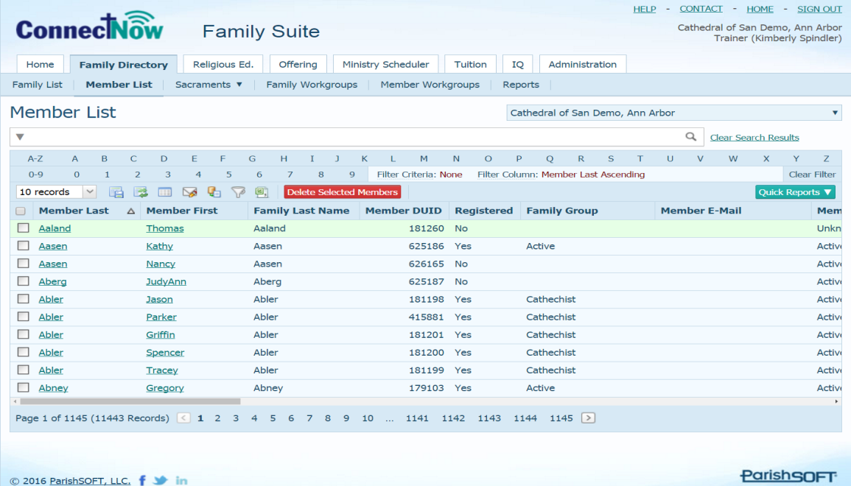
ConnectNow

Slide 8
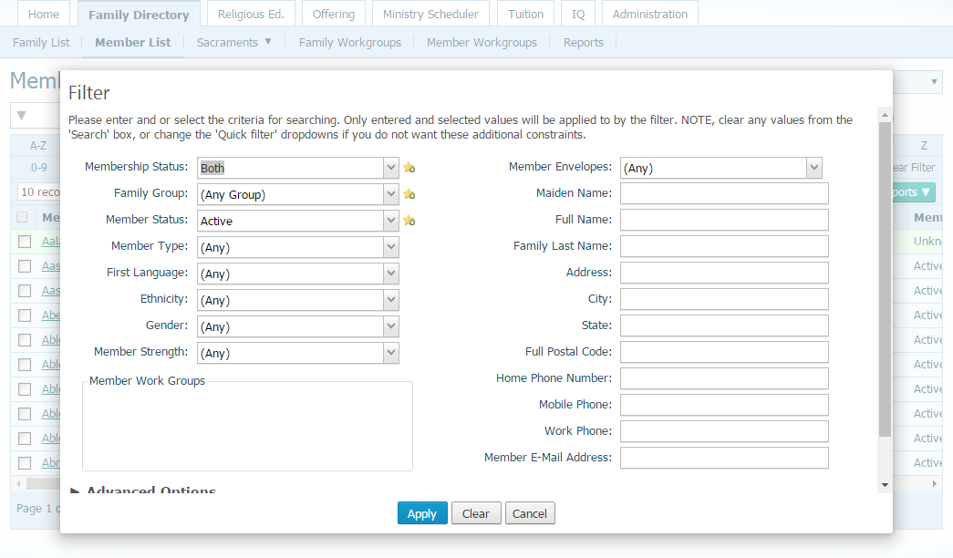
Filtering

Slide 9
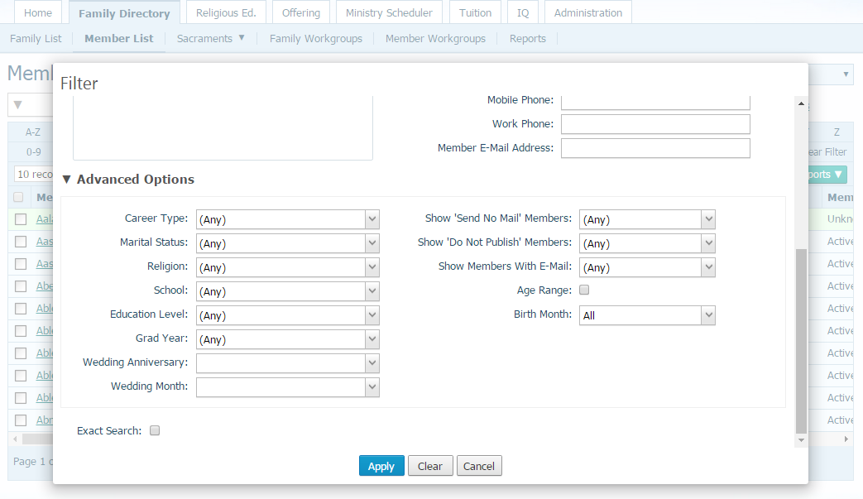
Filtering

Slide 10
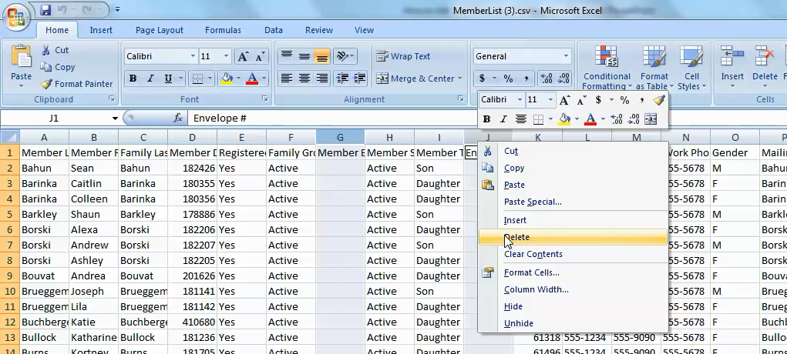
Excel

Slide 11
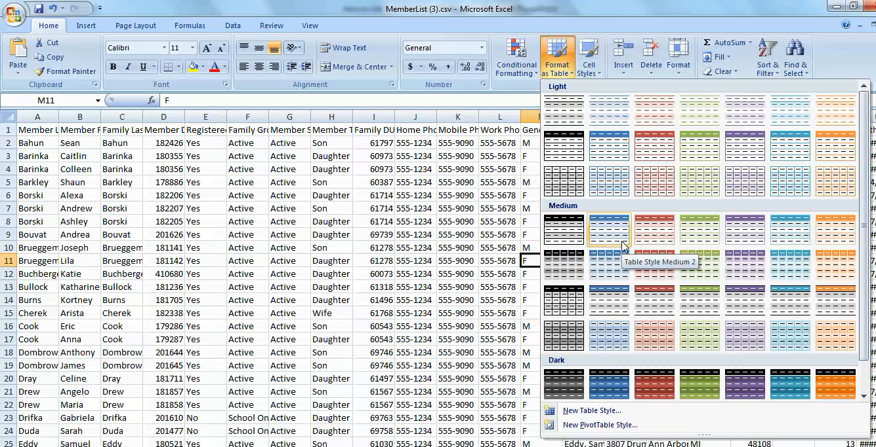
Excel

Slide 12
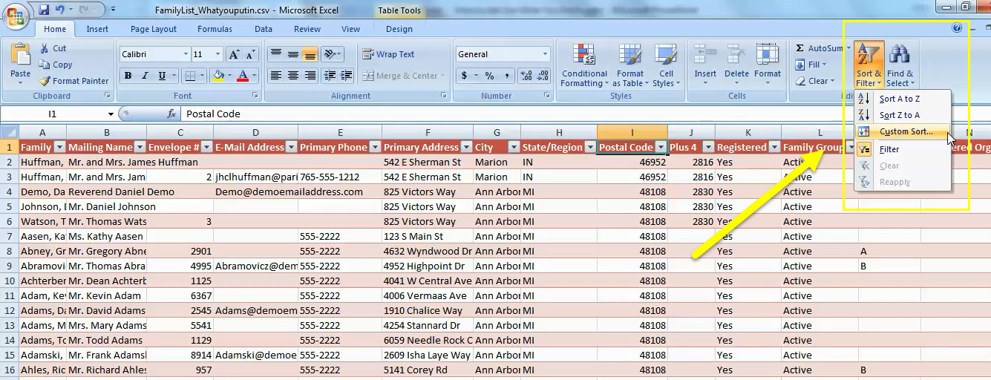
Excel

Slide 13
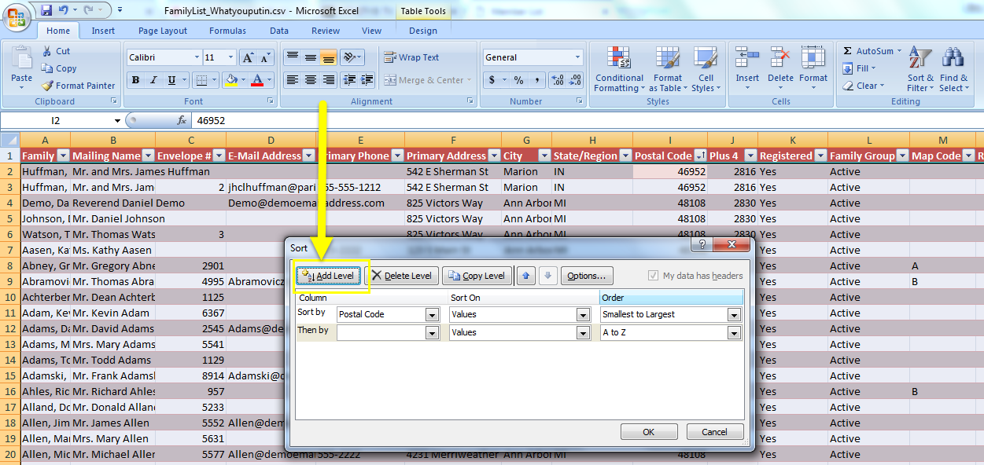
Excel

Slide 14
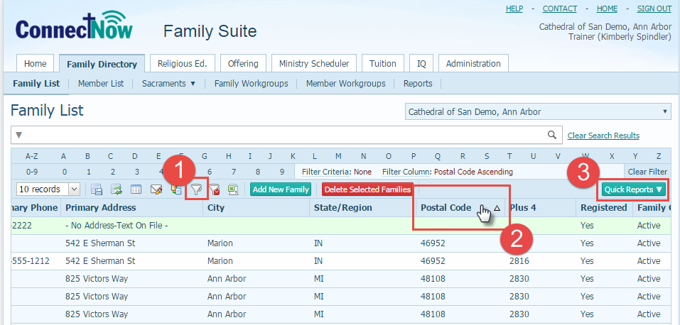
Mailing Labels by Zip Code

